Slide 1
No detection cases
For the photo cropping tool

Slide 2
1. Bad Angles
If the person is not facing to the camera, i.e. facing to the side or to the ground, there is a higher chance of detection failure

Slide 3
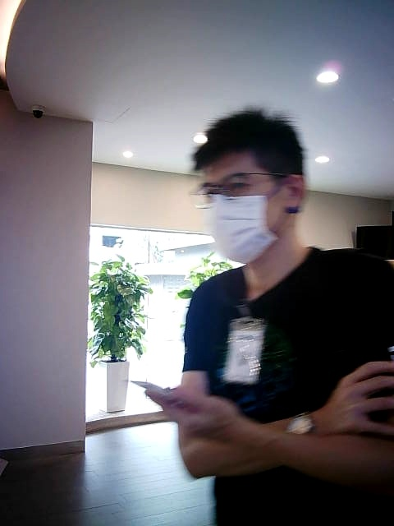
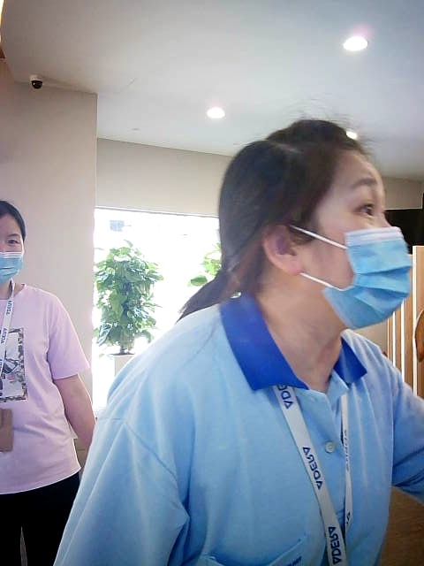
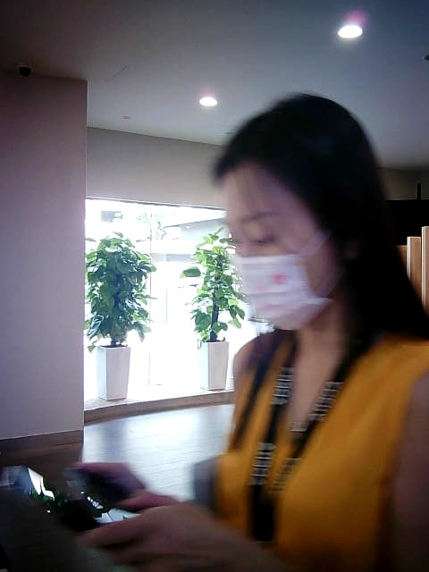
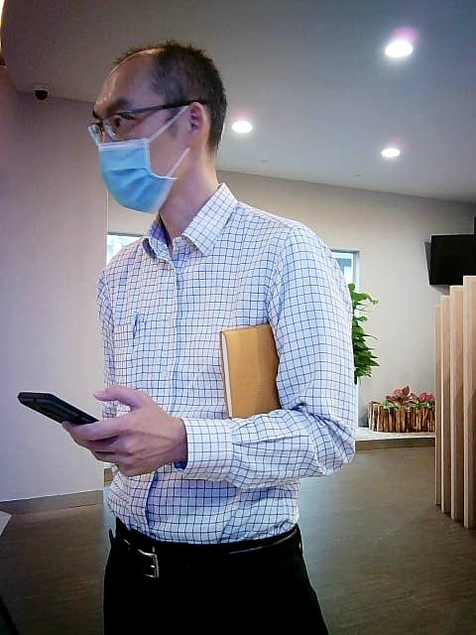

Slide 4
2. Not centered face
If the person’s face is too close to the frame of the photo and part of the face already exceeds the photo boundary, it would very likely fail the detection

Slide 5
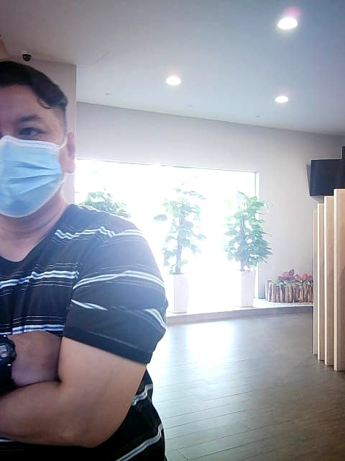
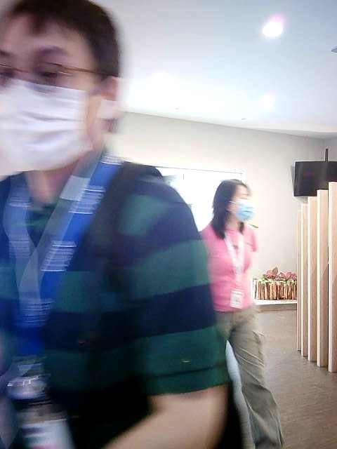
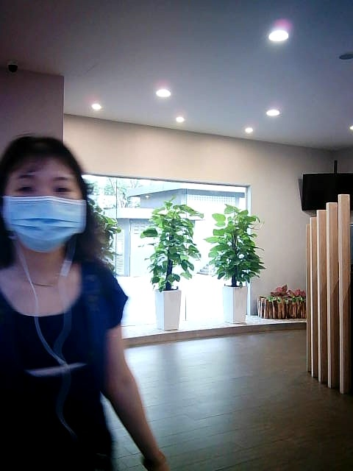

Slide 6
3. Masked faces
If the person is wearing a mask, or any other items covering the face, there is approximately 10%-20% of detection failures.

Slide 7
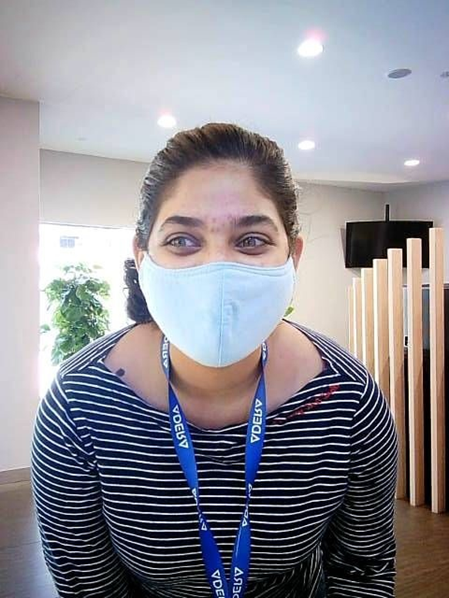
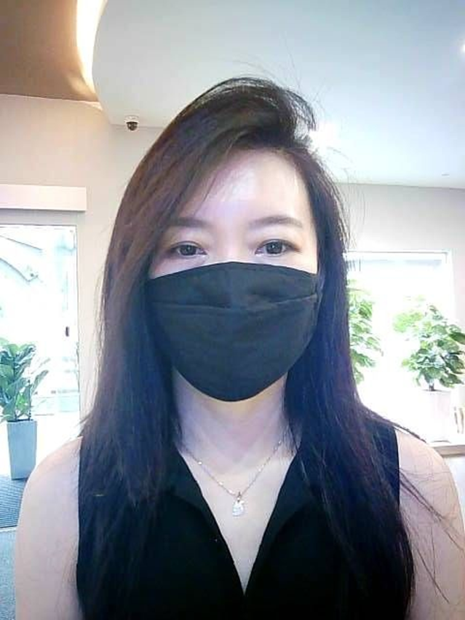
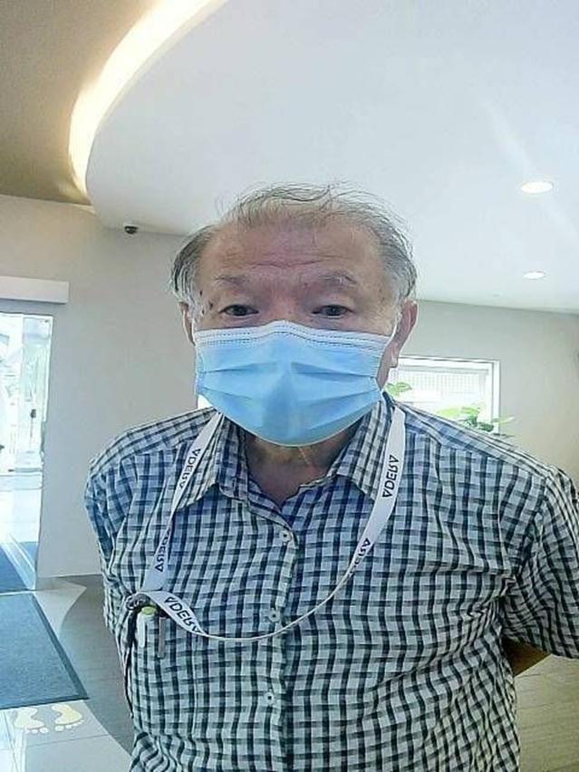

Slide 8
4. Glasses
If the person is wearing glasses but not wearing a mask, the detector can detect correctly. But if the person is wearing both mask and glasses, the failure chance is higher than wearing only a mask.

Slide 9
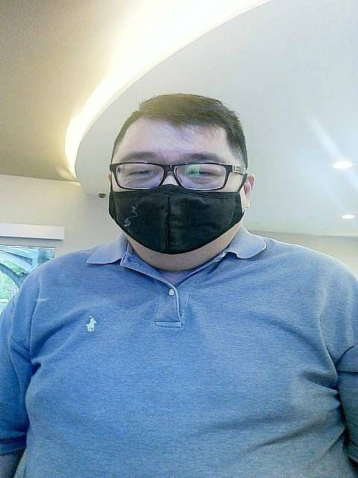
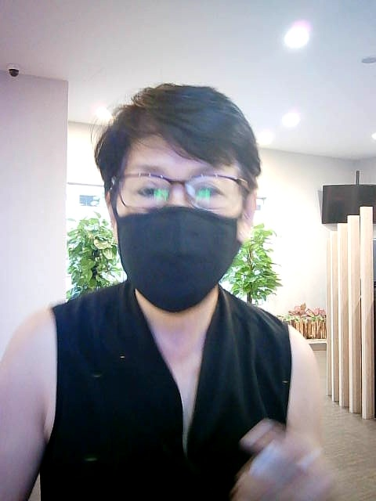
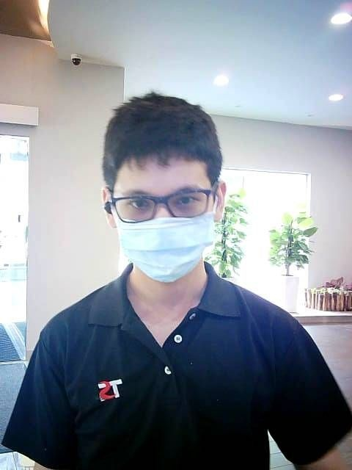

Slide 10
5. Hair covering face
If the person is not wearing a mask, the hair does not matter. If the person has hair covering the forehead and wears a mask at the same time, the failure chance is higher than wearing a mask without hair covering the forehead.

Slide 11
